Slide 1
1/20/2019
iXPAD
Project Mentor
Falguni Roy
Lecturer, IIT, NSTU
Submitted By
Abrar Hossain (ASH1825005M)
Azad Hossain (ASH1825014M)
Saima Nawal (MUH1825041F)

Slide 2
1/20/2019
Contents
Introduction
Objectives
Description
Deliverable
Requirements
Work Description
Timeline
References

Slide 3
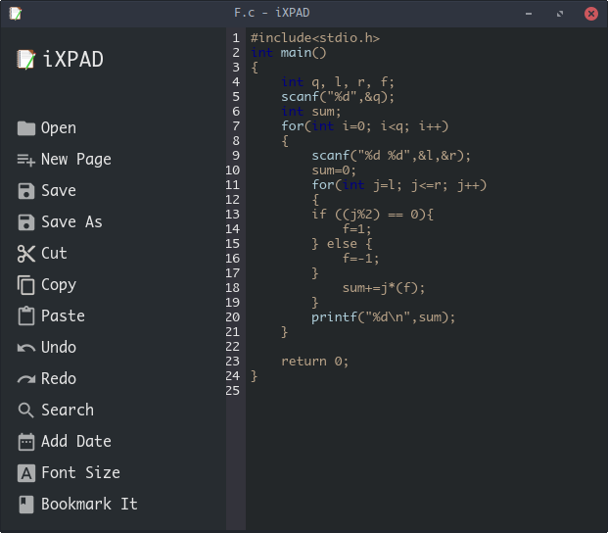
1/20/2019
Introduction

Slide 4
1/20/2019
Objectives
Through this project our goal is to learn
Usages of OOP features to solve real life problems.
Myers Algorithm.
Work as team for solving problems.
Creating desktop application.

Slide 5
1/20/2019
Objectives (cont…)
Through this project our goal is to create
A flavor of browser

Slide 6


features of ixpad
Features are two fold.
Regular features
WOW features

Slide 7
1/20/2019
Regular features iXpad
Capitalization of sentence or words
Line number
Multiple tab
Show recent opened files
Dark & light theme

Slide 8
WOW features iXpad
Bookmark ability
Checking duplicity of any text files
Support syntax highlighting for C & C++ language
Suggestions for words
Spell checking
Dictionary

Slide 9
1/20/2019
Project Deliverables
Source code (with a gitlab repository)
Documentation
User manual

Slide 10
1/20/2019
Scope
Make Windows based app

Slide 11
1/20/2019
Work description
Task | Active member
Proposal | Azad, Asif, Saima
Requirement analysis | Azad, Asif, Saima
Design | Azad, Asif, Saima
Study | Azad, Asif, Saima
Coding | Azad, Asif, Saima
Testing | Azad, Asif, Saima

Slide 12
1/20/2019
Proposed time line
Task | Deadline
Project proposal | 15th January
Requirement analysis | Within 21st January
Designing, study | Within 28th February
Coding | Within 3rd March
Final Testing | Within 7th March

Slide 13
Time Scale
Proposal
Requirement
Analysis
Designing&
Study
Coding
Final Testing
7 days 7 days 7 days 7 days 7 days 7 days
7 days

Slide 14
1/20/2019
References
https://github.com [accessed at : 9.45 pm (14.01.2019)]
http://blog.robertelder.org/diff-algorithm [accessed at : 7.45 pm (12.01.2019)]
https://stackoverflow.com [accessed at : 9.05 pm (12.01.2019)]
https://www.wikipedia.org [accessed at : 9.55 pm (14.01.2019)]

Slide 15
1/20/2019
Thank You

